Slide 1
Online-banking
GROUP NO – 9
TEAM LEAD – YADAV DHIRAJ RAJENDRA PRASAD

Slide 2
Real Life Lab(Rll)- Team Project Online Banking
Group Members:-
1. Yadav Dhiraj Rajendra Prasad
2. V Naga Lakshmi
3.V Sarathkumar
4. Vimalraj Mohanasundaram
5. Yalapalli Swaroop
6. Yarraguntla Obul Reddy
7. Yenugu Sravani

Slide 3
Problem Statement
The business analysts noticed a drop in the number of customers of the bank. They find out that online banking systems are making profits by eliminating the middle men. In order to eliminate the middle men we have to built a online application with a rich and user friendly interface. In this application user can perform all the operations without involving another person.

Slide 4
Abstract
It is for an online comprehensive solution to manage Online Banking .This is accessible to all customers who have a valid user id and passwords . In todays world a number of banks have either gone for online banking or are on verge of going for it. Online Banking enables the customers to transact business on line in real time.
Online banking system provides the facilities like Balance enquiry , Funds transfer , Loan enquires , Request for cheque book/change of address/viewing monthly and annual statements . Online banking system has developed a new security infrastructure for commerce on the internet . The initiative, called ICIN Bank aims to provide a secure infrastructure for customers.

Slide 5
Project Objective: Create a dynamic and responsive Java online banking web application to deposit ,withdraw , and transfer money between accounts.
Proposed System: In this system, Customer will have a unique login id and password. By using this id and password only user can enter into account and he can create a new account and perform operations. Admin will also have a unique id and password through which he can enter into application. He can block a account or he can accept or decline the loan request, cheque book request.

Slide 6
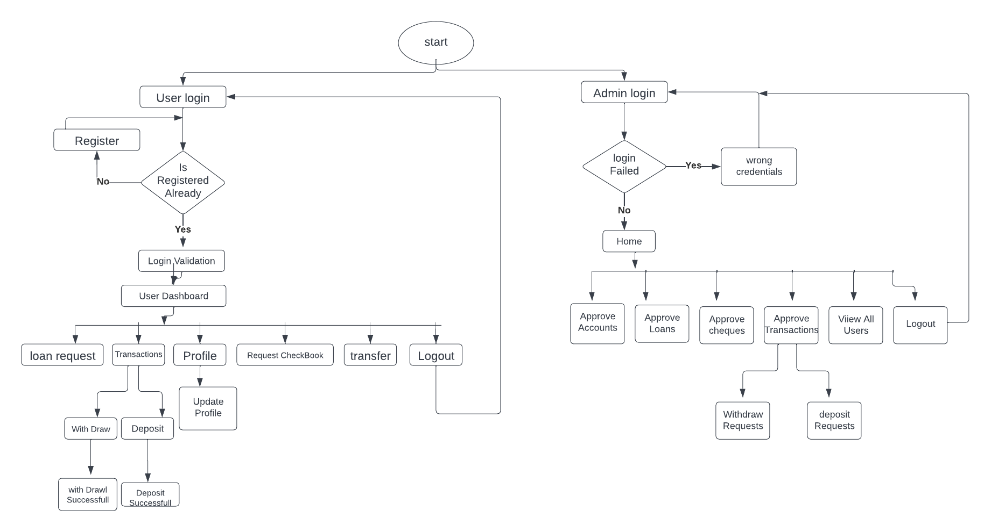
OVERALL FLOW CHART

Slide 7
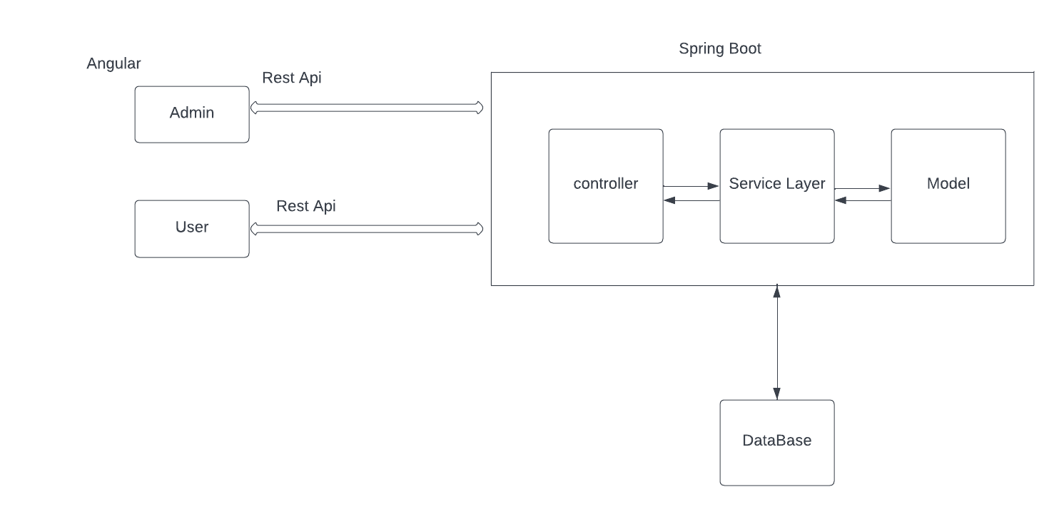
SPRINGBOOT ARCHITECTURE

Slide 8
MODULES
Administrator module
User Registration and Login module
Account module
Deposit module
Withdraw module
Loan request module
Cheque book request module
Transaction module
PostMan Testing

Slide 9
Administrator module
Admin action 1.Login to portal. 2.Grant access to the users regarding money transfer, deposits , and withdrawal. 3.Block a user account in case of any threat
4.Authorize cheque book requests. 5.Handel new loans requests and also view the list of all approved and rejected loan request. 6.View the funds transferred. 7. Check the balance.

Slide 10
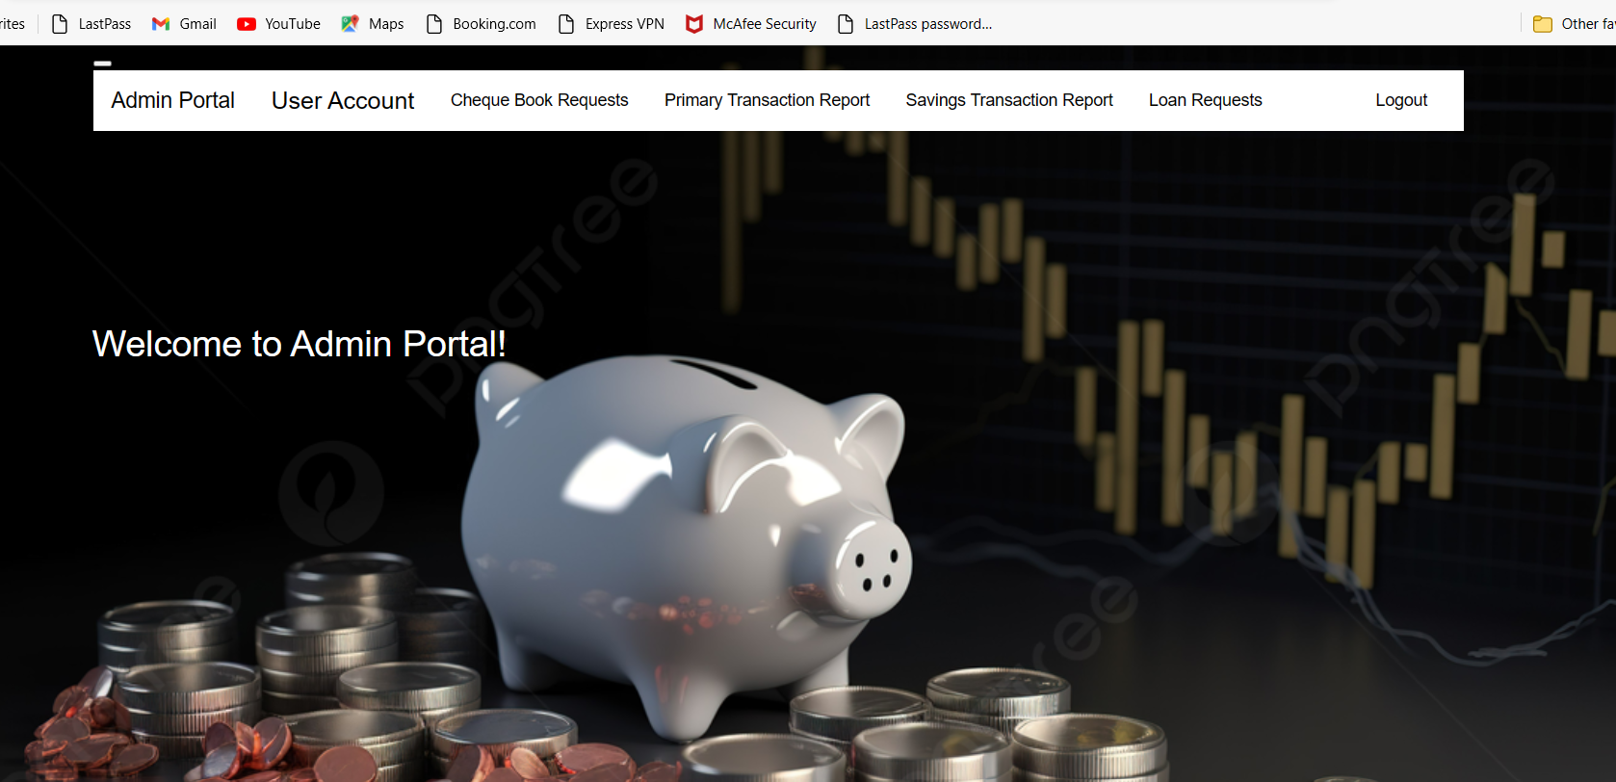
Admin Dashboard

Slide 11
REGISTRATION AND LOGIN MODULE
User actions: 1.Create account 2.Login to account. 3.User can change the password , address , email, and phone no. 4.User can deposit and withdraw money from the account. 5. User can view the balance in their primary and savings account. 6. User can request for cheque book for different accounts. 7. User can apply for loan.

Slide 12
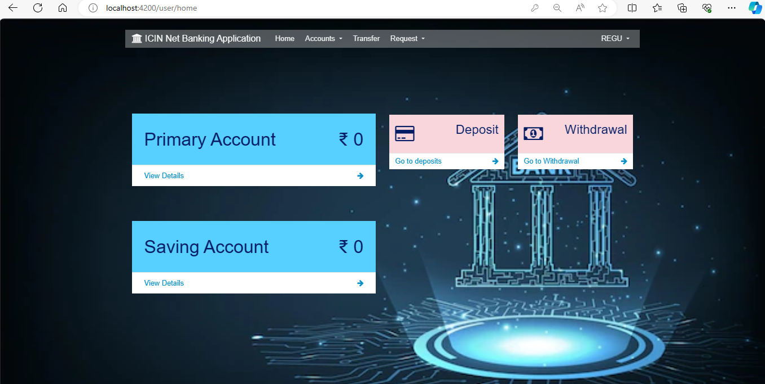
User Dashboard

Slide 13
Account Module
In account module user is able to see the details of his/her account.
There are two types of accounts Primary Account and Saving Account
In Saving Account we can only deposit and withdraw the money.
In Primary Account we can do the operation of transfer and we can request for Loan and Chequebook also.

Slide 14
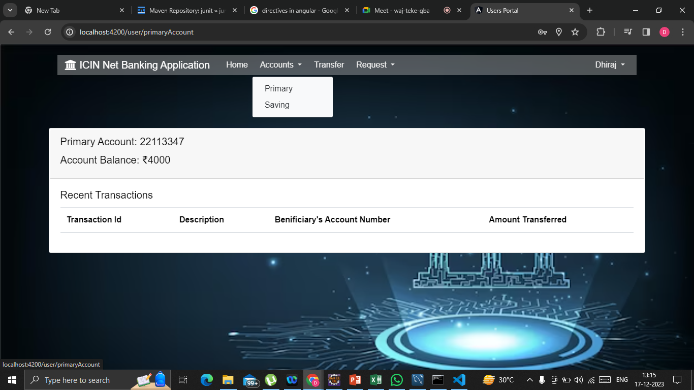
Primary Account

Slide 15
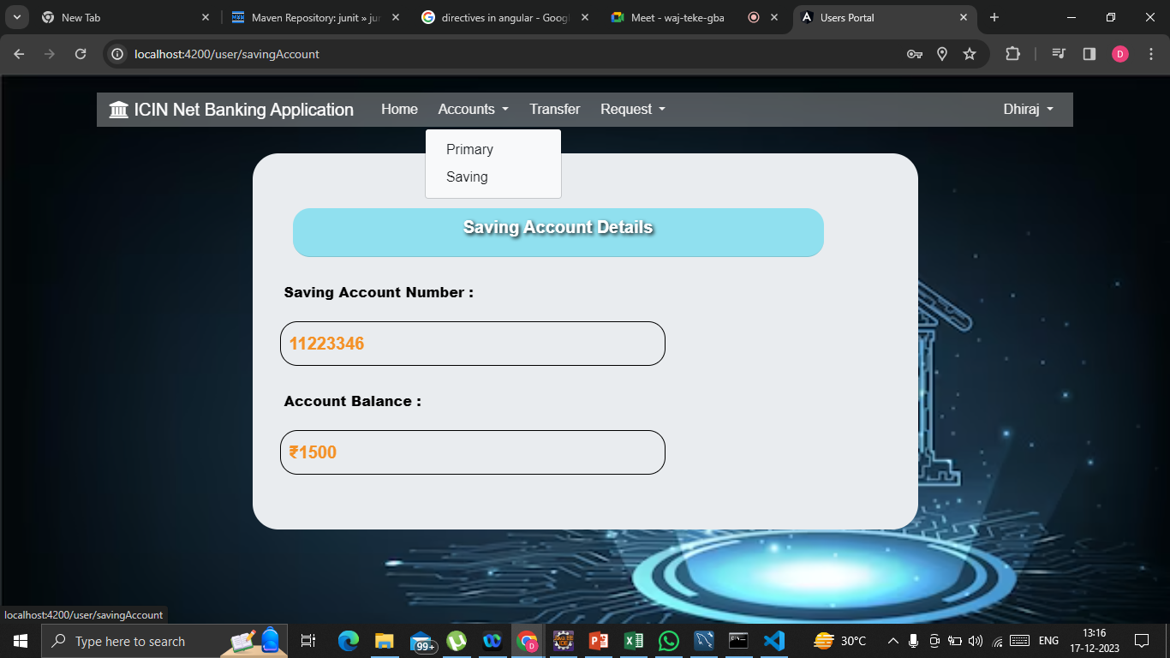
Saving Account

Slide 16
Deposit module
In Deposit module the user can deposit money to the account .
The User need to click on the Deposit option provided in the user portal and needs to enter the amount to be deposited .
The amount he/she entered will be credited to his account and the same Reflected in Account Balance.

Slide 17
Withdraw module
In withdraw module, the user can withdraw money from the account.
The User need to click on the withdraw option provided in the user portal needs to enter the amount to be withdrawn.
The amount he/she entered will be debited from his account and Reflected in the Account Balance.
The amount user entered to withdraw must be less than the amount present in the account (Account Balance). (Withdraw <= Balance).

Slide 18
Loan request module
In loan request module the user have to give the description of loan like which type of loan (Home loan ,Educational loan , etc) and how much amount he is requesting.
The request send to Admin for approval after admin approves the user can take the loan amount.

Slide 19
Cheque book request module
To maintain details of requested cheque books and update the status of checks in each issued cheque book, use the ‘Cheque Book Request Detail’ screen.
User can apply for cheque book .
After admin will be Notified and approval the user can get checkbook

Slide 20
Transaction Module
The transaction amount from the Transaction object using the statement
Long transactionAmount = transaction.getTransactionAmount();
Updates the source account balance by subtracting the transaction amount
sourceAccount.setAccountBalance(sourceAccount.getAccountBalance() - transactionAmount);
Updates the destination account balance by adding the transaction amount:
destinationAccount.setAccountBalance(destinationAccount.getAccountBalance() + transactionAmount);
This set of code represents the logic for transferring the transaction amount from the source account to the destination account. It involves subtraction from the source account and addition to the destination account.

Slide 21
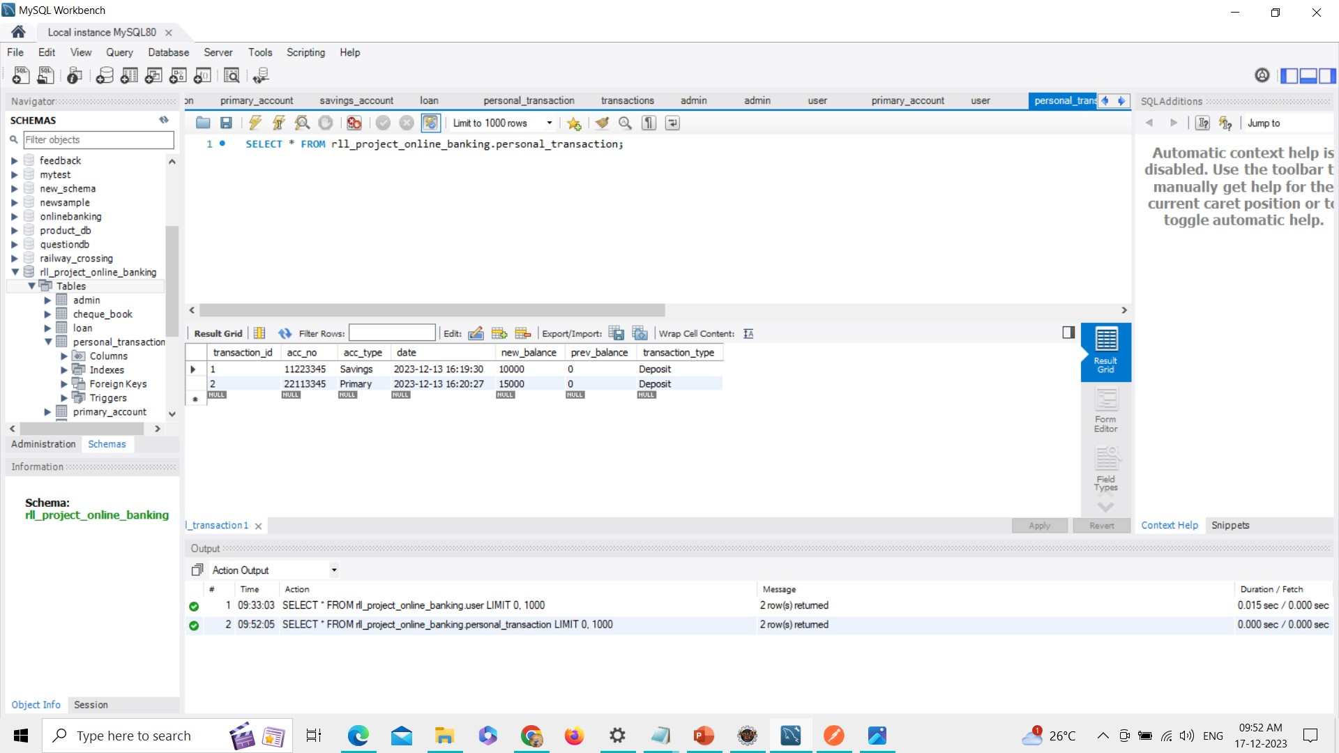
Transaction Database

Slide 22
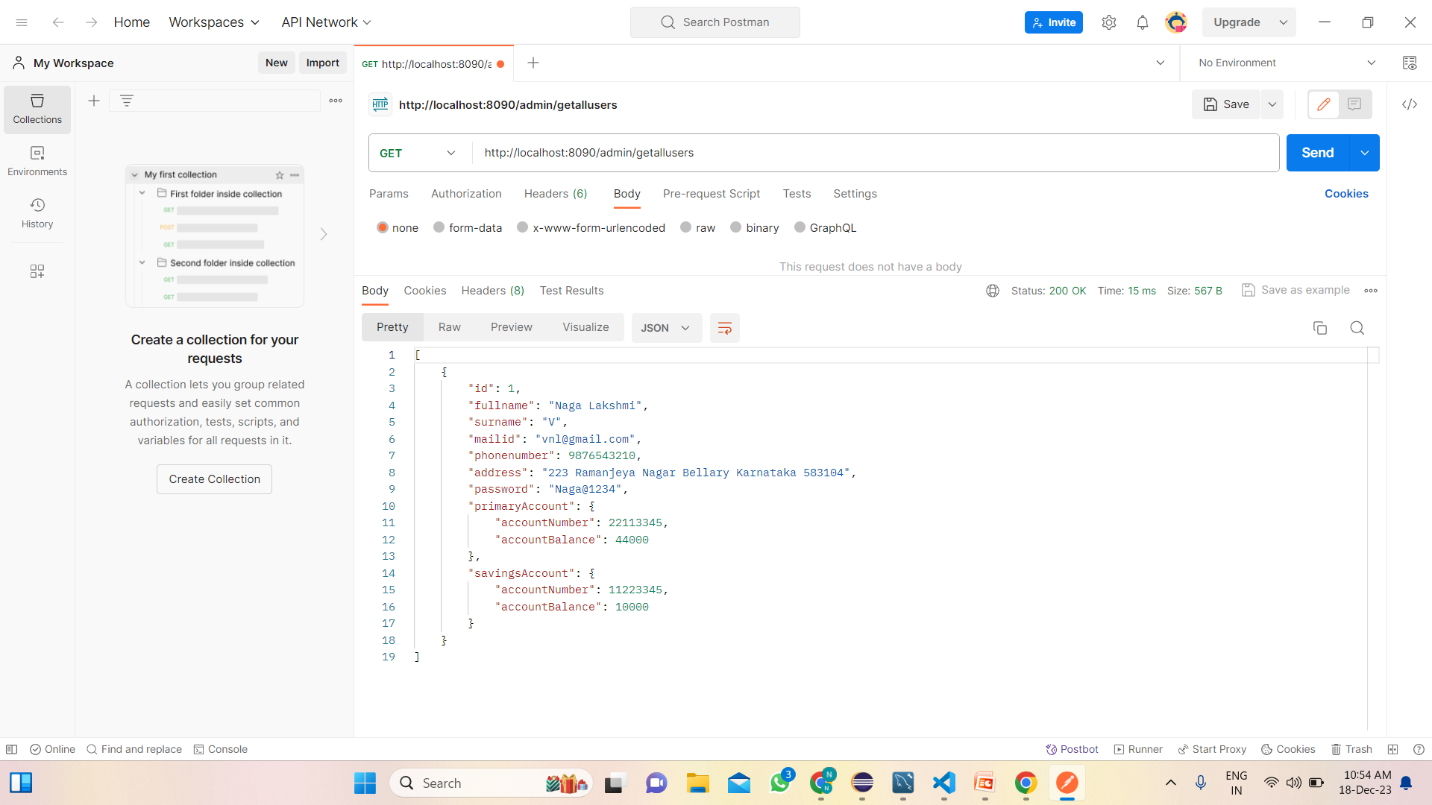
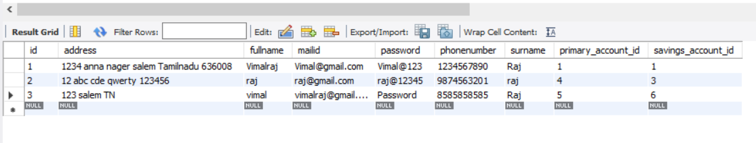
Functional Testing

Slide 23
Tools and Technologies:
Front-End : Angular
Server-side :Spring Boot
Back-end :MYSQL, Hibernate
Web Server : Tomcat

Slide 24
DATA BASE
Database: rll_project_online_banking
Tables: admin
account
cheque_book
loan
personal_transaction
primary_account
savings_account
transaction
user

Slide 25
CONCLUSION
The creation of online banking is done successfully and is tested for the accurate results. During the completion of this project all the requirements for the project are accomplished and it meets the organisation needs.

Slide 26
Thank you for your time and attention

